Slide 1
iSearch+
Smart News Search Engine
Group Members: Yifan Wang, Qi Jiang, Jingyang Guo

Slide 2
Why called “iSearch PLUS”?
Search Engine PLUS Data Miner
(1) Search source:
News articles from major news media
(2) Data miner:
Mine some interesting points using statistical and machine learning techniques from news

Slide 3
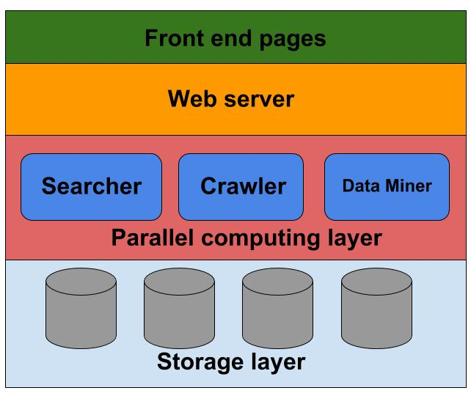
Overall architecture
Front end
Web server
Computing Layer
Storage

Slide 4
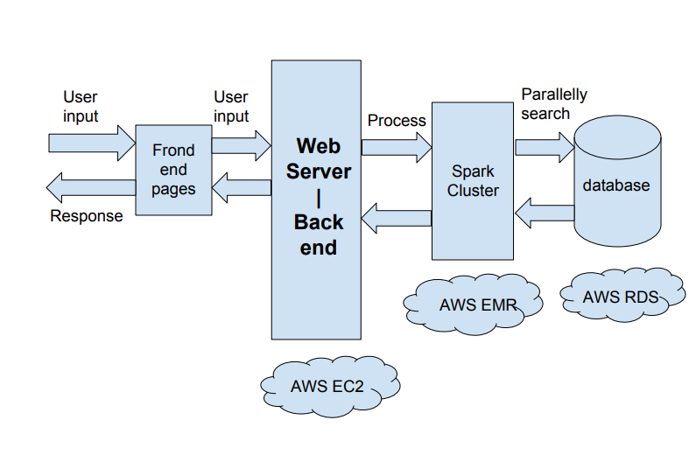
Main flowchart

Slide 5




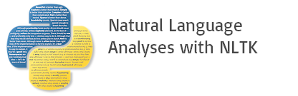
Technique Stack

Slide 6
Modules - Web server
Framework: Python Tornado
Deployed platform: AWS EC2
Reverse proxy: Nginx

Slide 7

Modules - Web server
Why Tornado?
Real-time web server:
Tornado was built to support async operations, even earier than Python!
Tornado: Real Time Web Server

Slide 8
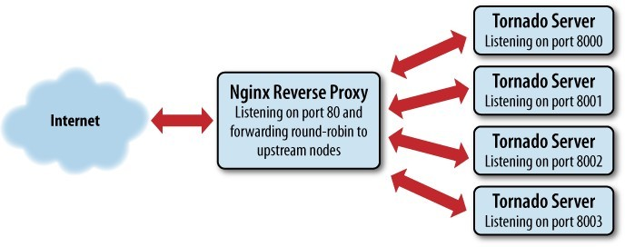
Modules - Web server
Why Nginx?
Isolate front end and back end more clearly.
Load balance
Simpler to filter data stream

Slide 9
Modules - Crawler
Typical parallel computing issue:
News sources and articles have no relationship with each other.
2. Use multi-threaded technique to speed up crawling

Slide 10
Modules - Searcher
Parellel
Look up inverted index table
Sort the documents
Present to users

Slide 11
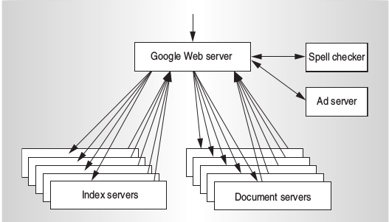
Searcher - Overview
Inside a search process:
1. Input and process query string
2. Search identifiers of relevant documents to the query keywords
3. Search and return document content by the identifiers
Google’s Search Engine Architecture (Also ours)

Slide 12
Searcher - Input Processing
Input: the search content from users(some keywords or sentences)
NLTK Package:
filter useless content
tokenize sentences into some words
generate synonyms(to implement the fuzzy search function)

Slide 13
Searcher - Main Process
Typical situation for parallelization
(1) Generate inverted index using Spark parallelly
(2) Search releveant document identifiers by inverted index
a) Compute relevance scores parallelly
(3) Search document content using Spark SQL

Slide 14
Modules - Storage
Inverted index table
Documents
User data

Slide 15



Modules - Front end

Slide 16

Modules - Front end
Enter what you are concerned

Slide 17

Modules - Front end
Sign-in and Sign-up Page

Slide 18
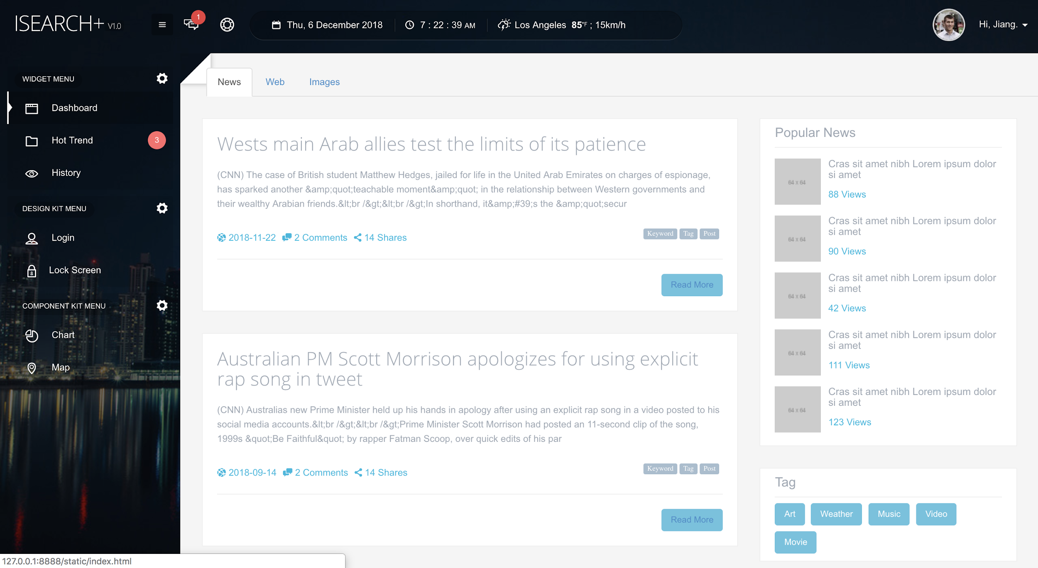
Modules - Front end
News Title
Preview Content
Publish Date
Read More

Slide 19
Modules - Data Miner
Collected data from searcher is arranged according to certain rules
Data mining algorithms are applied to searched data

Slide 20
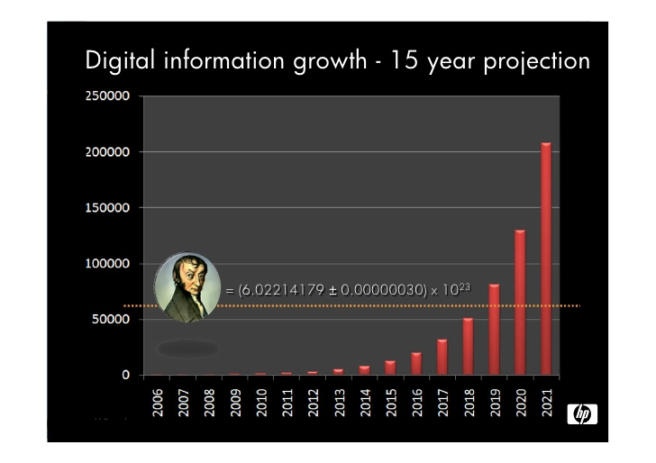

Data Miner - Significance
Humans’ demands for getting up-to-date information
Gigantic quantity of information in news
Extract and analysis valuable data

Slide 21




Data Miner - Toolkits

Slide 22
Data Miner - Algorithms
Text summarization
TextRank
Speech Tagging
Contrastive Conjunction
(Subj + Verb + Obj, but Subj + Verb + Obj)
...

Slide 23
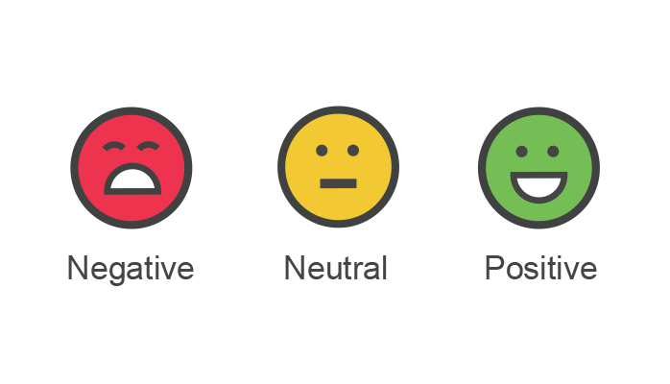

Data Miner - Sentiment Analysis
Significance:
Analysis the attitude of media or public towards a topic
Serve as an evaluation for business, policy, literature, sport usages

Slide 24
Data Miner - Sentiment Analysis
Collect searched results on one topic
Analysis on each article
Calculates the positive / negative / neural rate for the topic

Slide 25
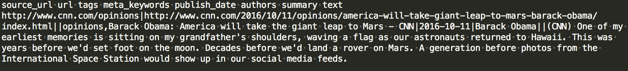
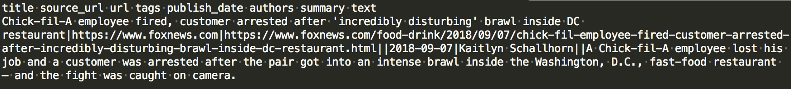
Data Miner - Sentiment Analysis

Slide 26
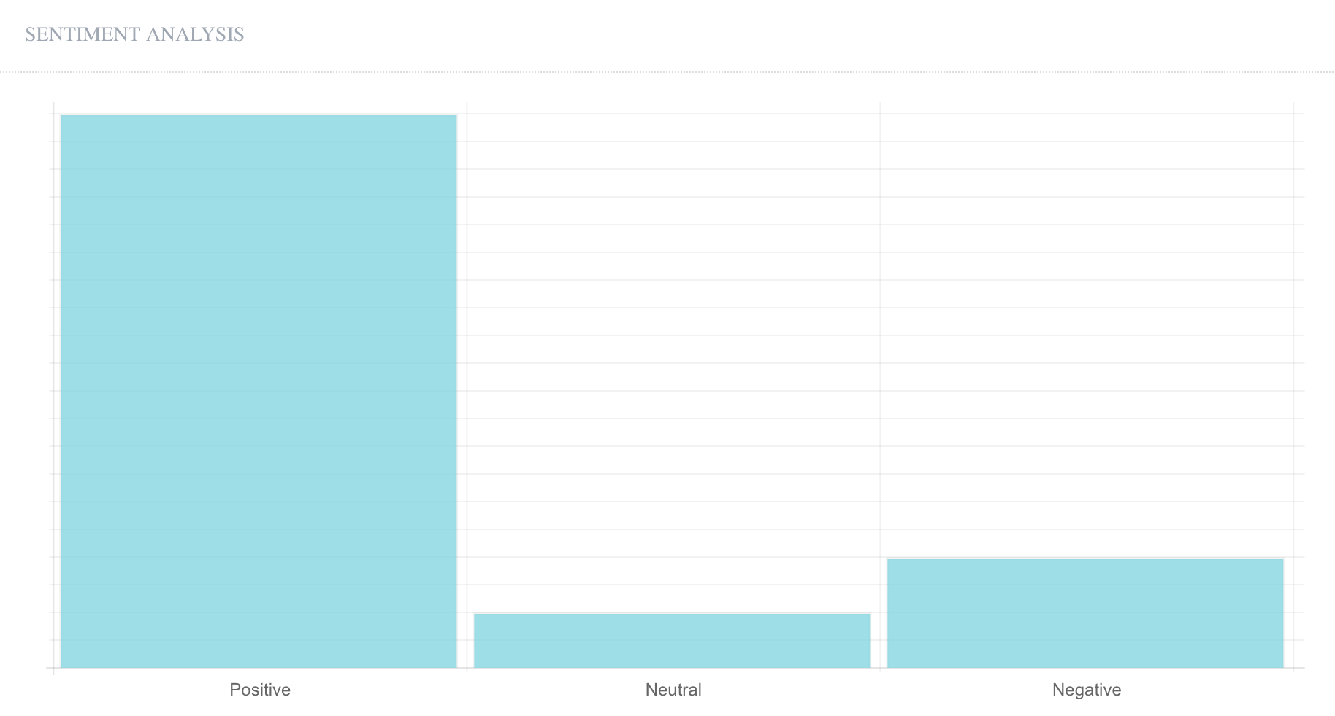
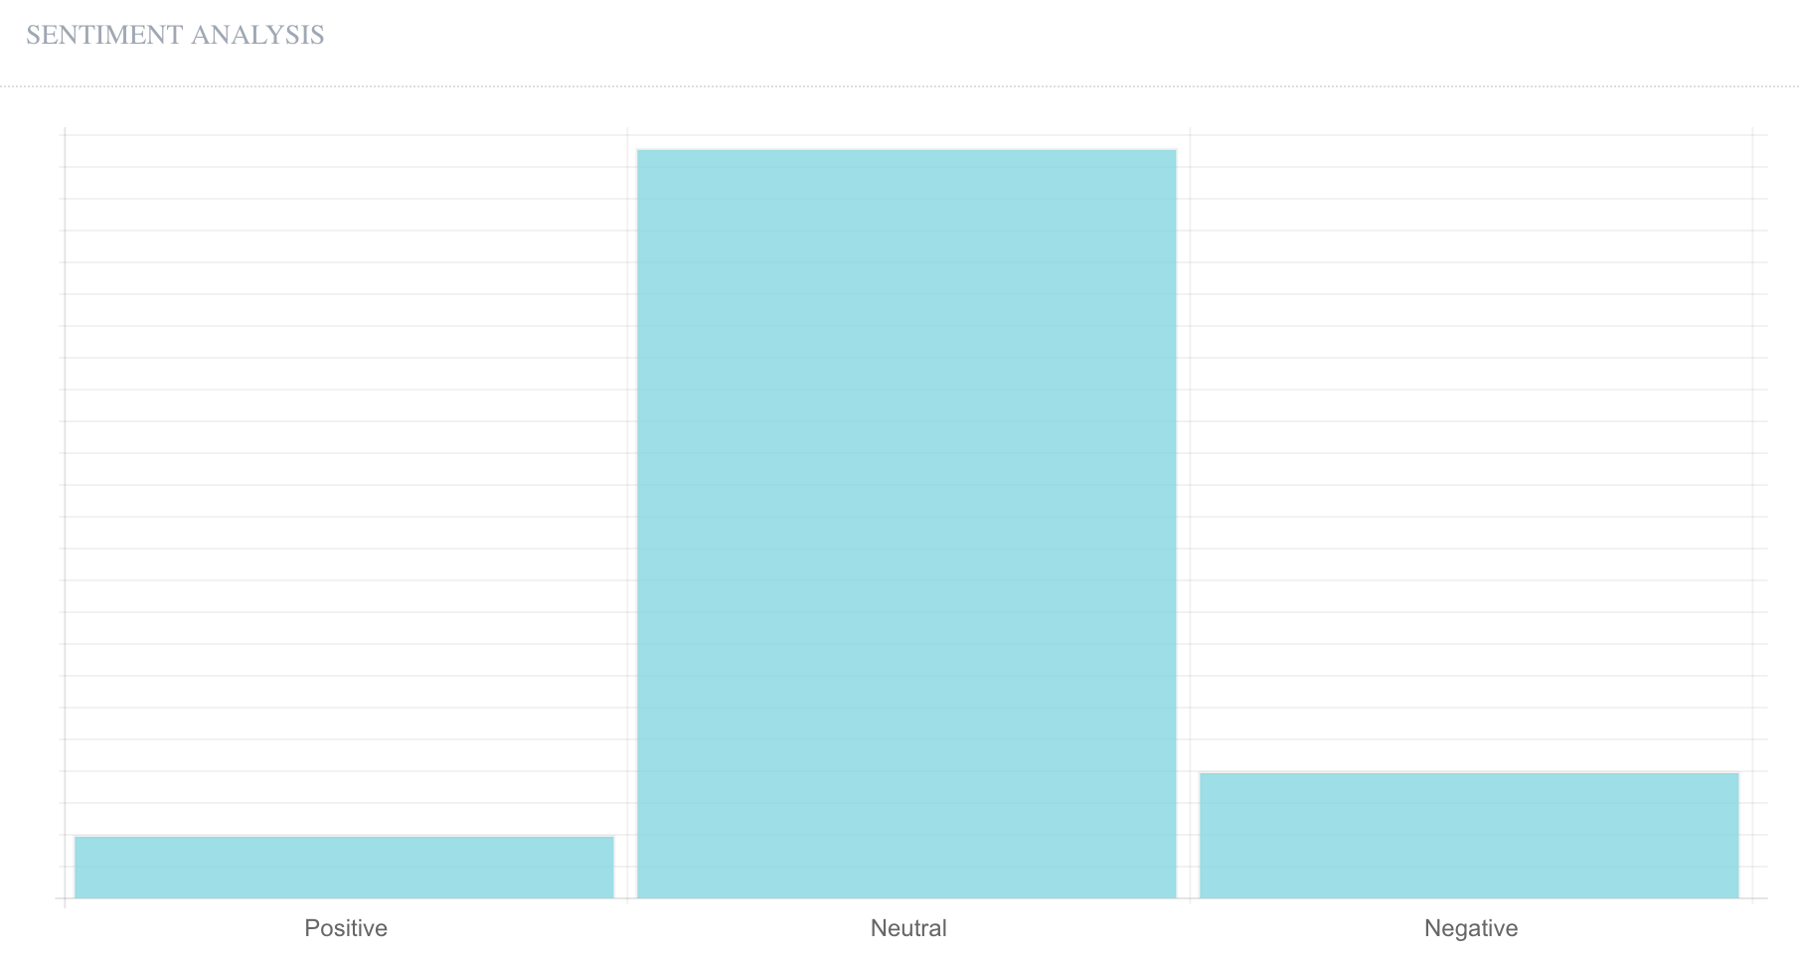
Data Miner - Sentiment Analysis

Slide 27
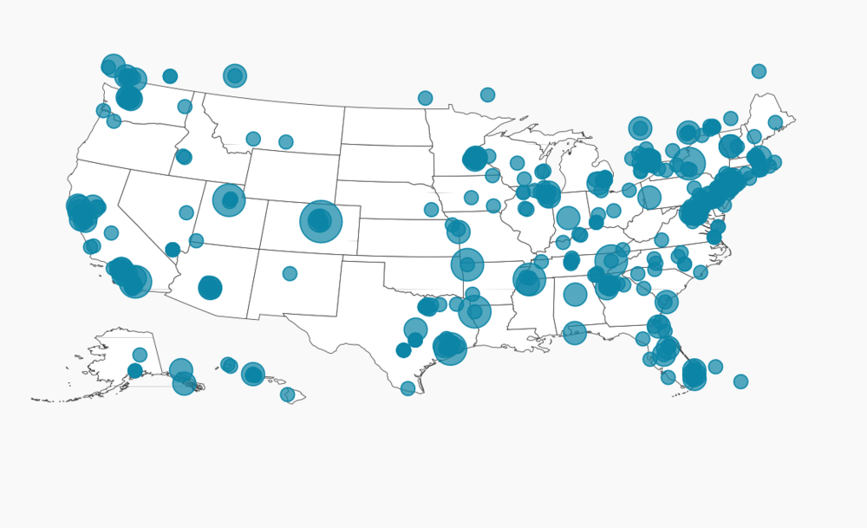
Data Miner - Mapper
Significance:
Get topic heat on different locations
Contributes to business product heat analysis, media / public interest regional research, etc.

Slide 28
Data Miner - Mapper
Collect searched results on one topic
Analysis on the location (country, city, ...) information
Calculate the location heat rates
Generate the hotspot map

Slide 29
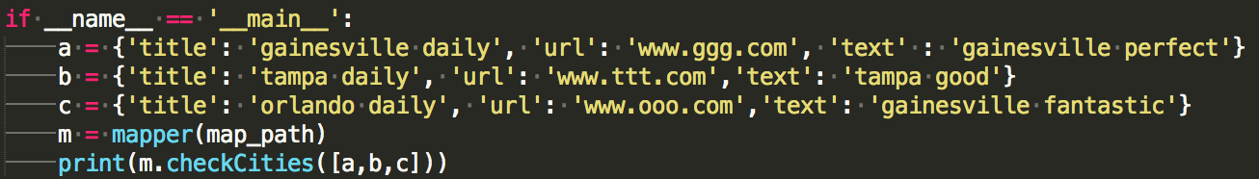
Data Miner - Mapper

Slide 30
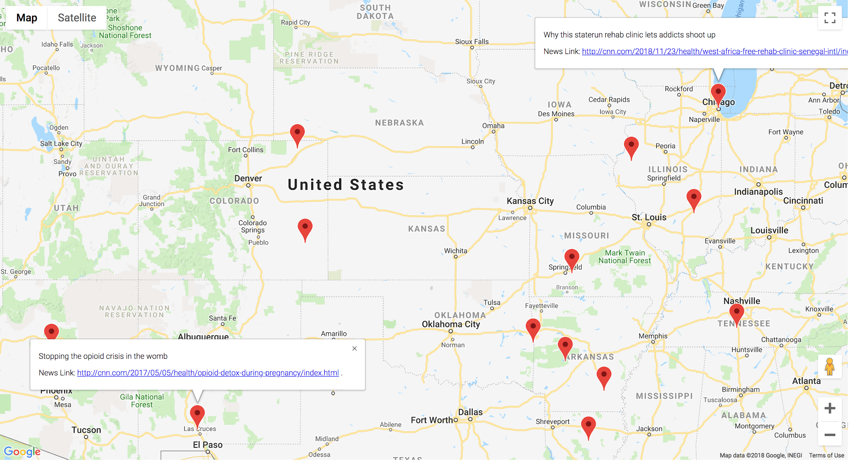
Data Miner - Mapper

Slide 31
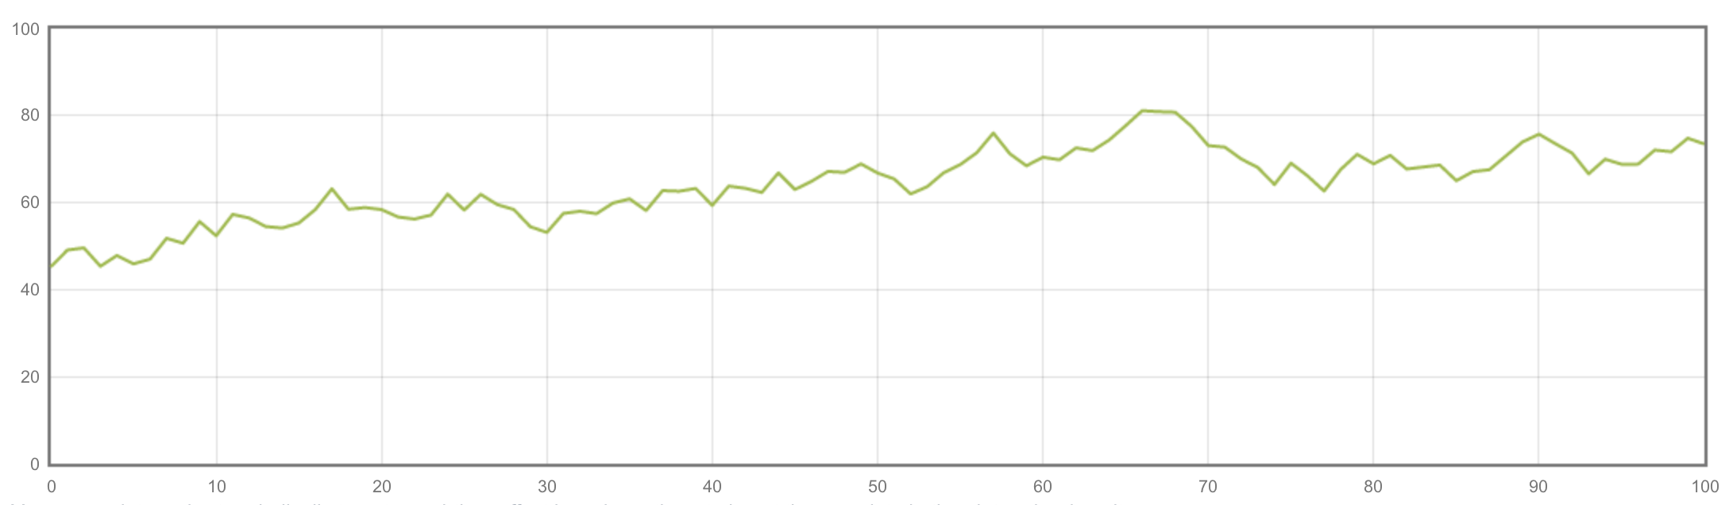
Data Miner - Hot Trend
Get hot news which contain hot keyword.
Hot keywords are the topic words show frequently among all the news.
With hot news, users can get information about the hottest trend. It is useful!

Slide 32
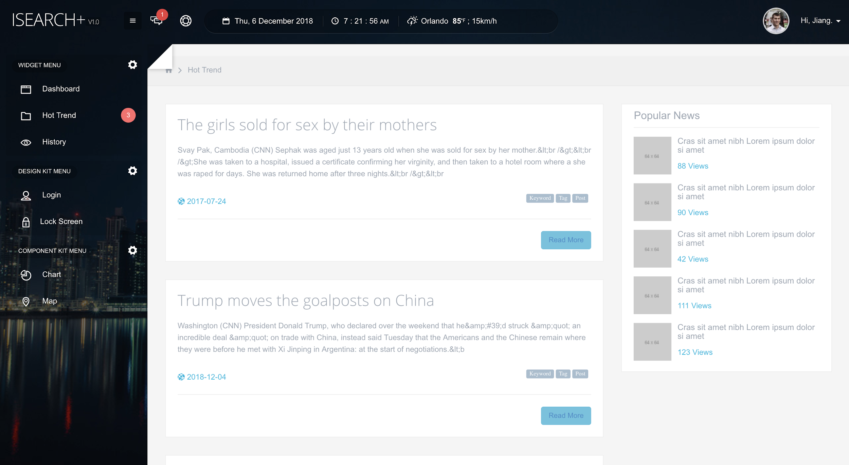
Data Miner - Hot Trend

Slide 33
References
[1] Brin S, Page L. The anatomy of a large-scale hypertextual web search engine[J]. Computer networks and ISDN systems, 1998, 30(1-7): 107-117.
[2] Thelwall M. A web crawler design for data mining[J]. Journal of Information Science, 2001, 27(5): 319-325.
[3] Paramkusham S. NLTK: THE NATURAL LANGUAGE TOOLKIT[J].
[4] Sauls C, Leithead T, Tokumi R. Synonym and similar word page search: U.S. Patent 7,822,763[P]. 2010-10-26.
[5] Zaharia, Matei, et al., ``Spark: Cluster computing with working sets.'', HotCloud 10.10-10 (2010): 95.
[6] Isele, Robert, et al. "LDspider: An open-source crawling framework for the Web of Linked Data." 9th International Semantic Web Conference (ISWC2010). 2010.

Slide 34
References
[7] Kreps, Jay, Neha Narkhede, and Jun Rao. "Kafka: A distributed messaging system for log processing." Proceedings of the NetDB. 2011.
[8] Ranjan, Rajiv. "Streaming big data processing in datacenter clouds." IEEE Cloud Computing 1.1 (2014): 78-83.
[9] Pang, Bo, and Lillian Lee. "Opinion mining and sentiment analysis." Foundations and Trends® in Information Retrieval 2.1–2 (2008): 1-135.
[10] Alexander, Carol. Market models: A guide to financial data analysis. John Wiley \& Sons, 2001.
[11] Brin, Sergey, and Lawrence Page. "The anatomy of a large-scale hypertextual web search engine." Computer networks and ISDN systems 30.1-7 (1998): 107-117.
[12] Lei, Yuangui, Victoria Uren, and Enrico Motta. "Semsearch: A search engine for the semantic web." International Conference on Knowledge Engineering and Knowledge Management. Springer, Berlin, Heidelberg, 2006.

Slide 35
Thank you

